Slide 1
WEST C4 ICRH System Status and Coupling
19/03/2020 WEST TFM – Virtual Edition
CEA: J.Hillairet, L.Colas, F.Durand, G.Lombard, P.Mollard
IO: W.Helou

Slide 2
C4 Main Results

Slide 3
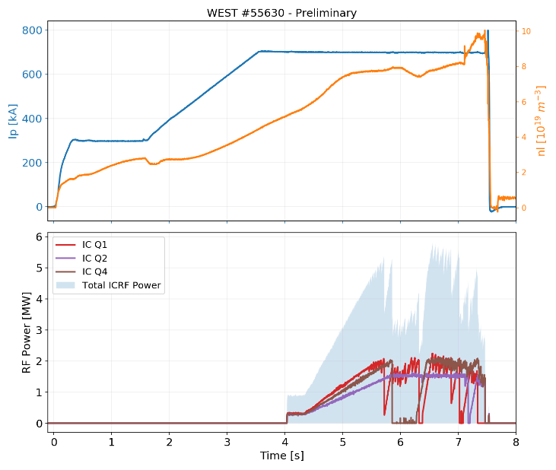
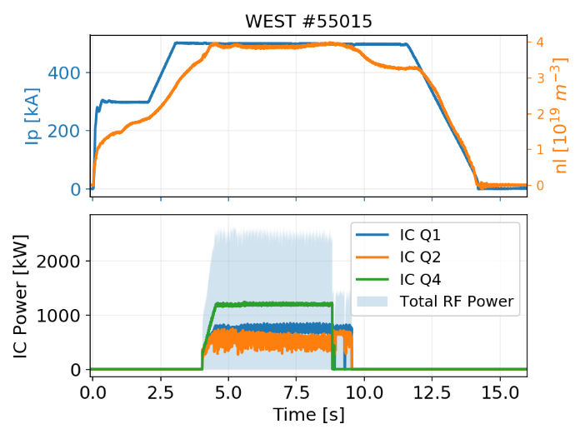
WEST ICRH System: Summary for C4
Main Results Achieved:
RF plant reliable due to good maintenance during shutdown
All three antennas operational simultaneously on plasma
3 MW/few seconds, 5 MW/500ms, and close to 6 MW peak.

Slide 4
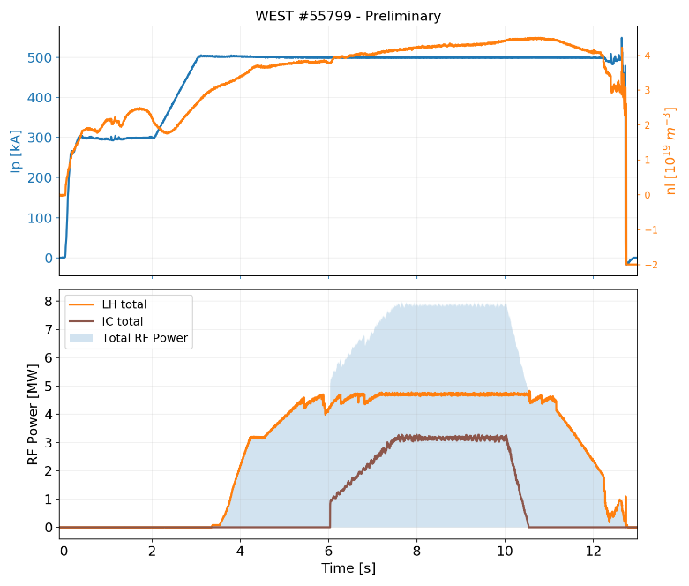
WEST ICRH System: Summary for C4
Main Results Achieved:
RF plant reliable due to good maintenance during shutdown
All three antennas operational simultaneously on plasma
3 MW/few seconds, 5 MW/500ms, and close to 6 MW peak.
Up to 8 MW total RF power (IC + LH) (close to 9 MW peak)

Slide 5
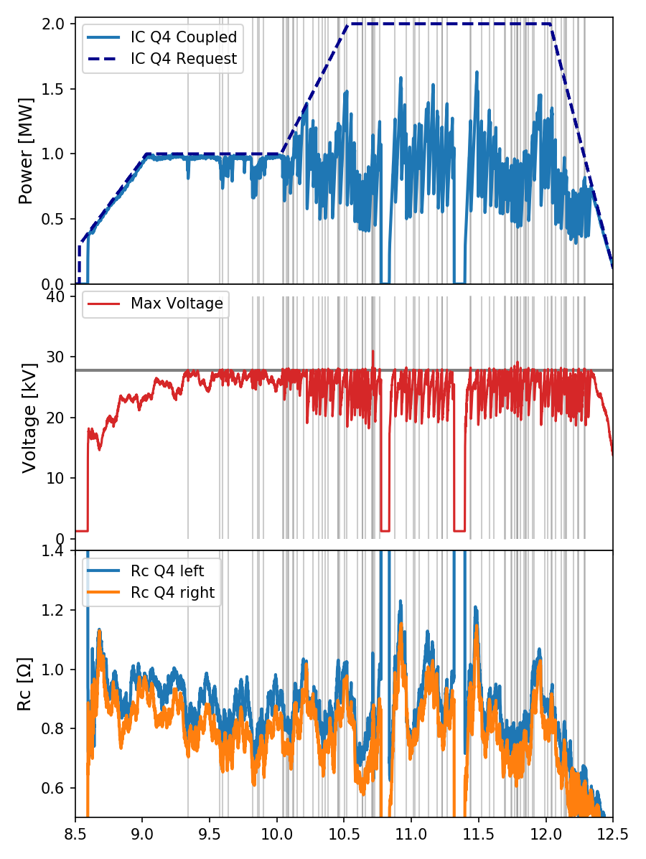

Max RF Power is usually limited by Low Coupling Conditions
Example: #54719 (3.7T/500kA)
1st plasma after Boronization
LH: 3.6 MW
IC: Q4 only
f_{rad} ~ 30-40% (bulk)
Power feedback due to max voltage safety limits reached (28 kV, gray zones)
Limits reached because coupling is low
Rule of thumb: Max Power/ant [MW] ~ 1.3 x Rc [Ω]

Slide 6

Improve Coupling

Slide 7
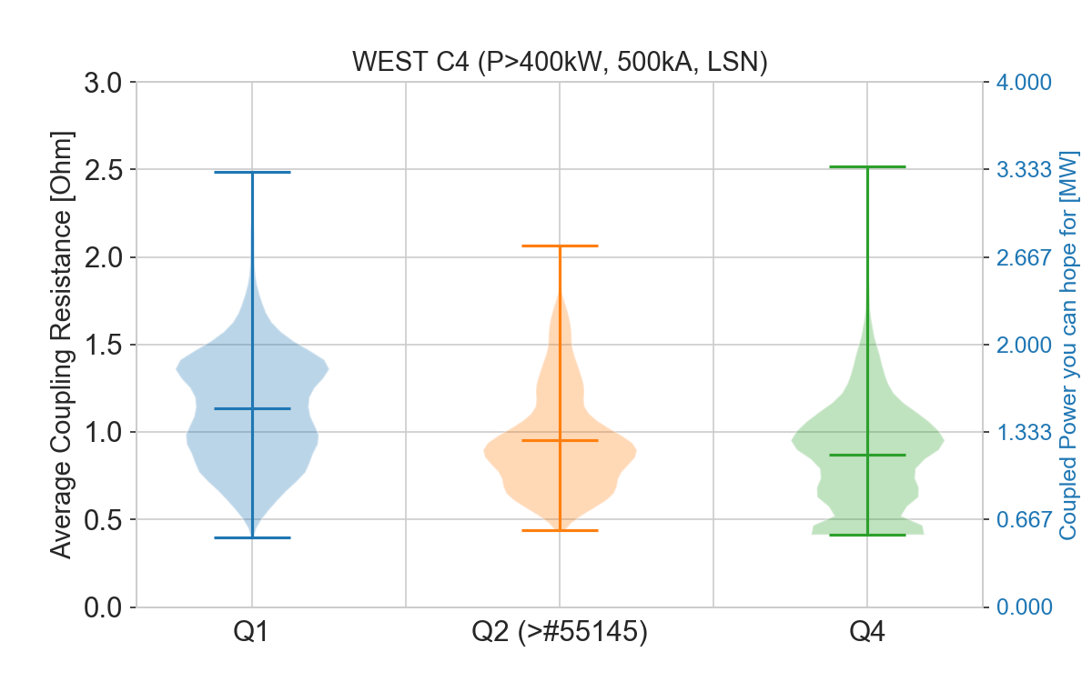
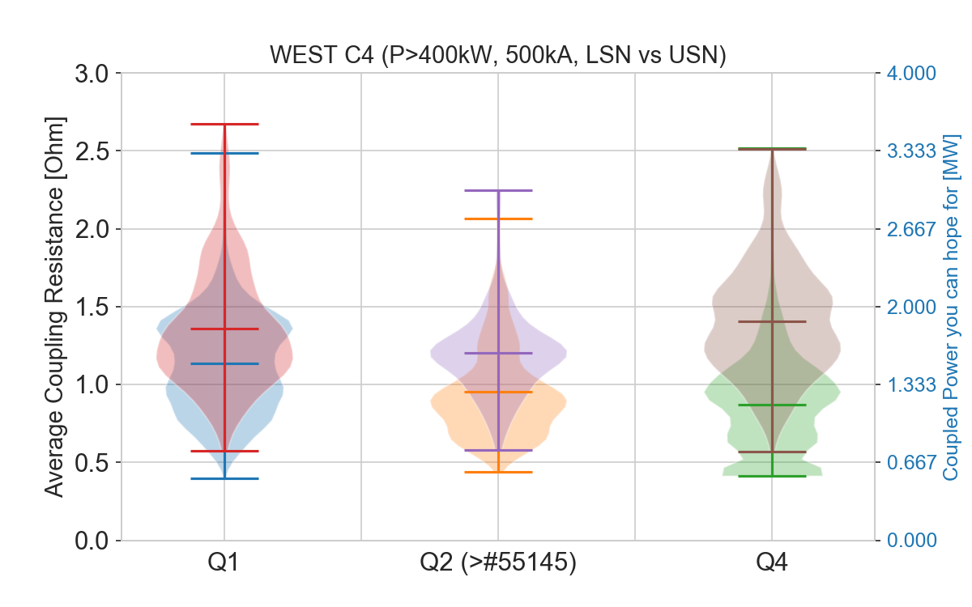
Improving Coupling: LSN vs USN
Coupling resistance is improved by 20 to 50% for 500 kA plasma
(should be treated cautiously…)

Slide 8
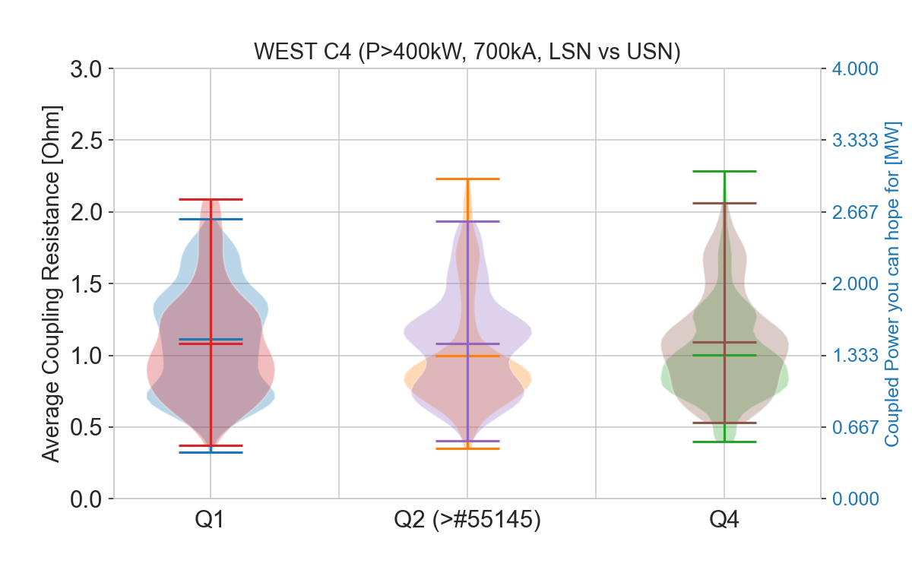
Improving Coupling: LSN vs USN
No major difference between LSN and USN plasma at I_{p}=700 kA
(should be treated cautiously…)

Slide 9
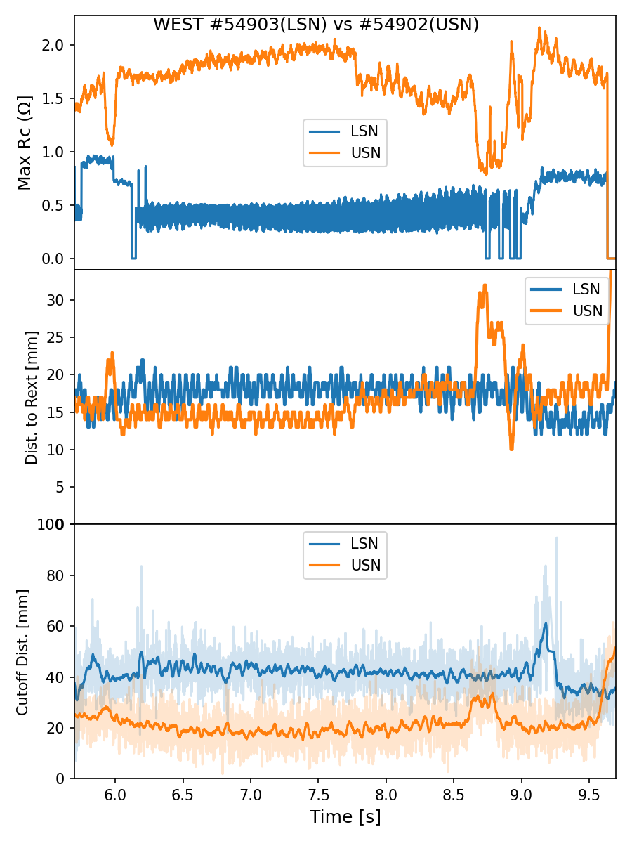
Improving Coupling: LSN vs USN
Why do USN plasma have better coupling?
Inverting poloidal currents from #54902 (USN) to #54903 (LSN)
Distance R_{ext} median to antenna:
Larger in LSN than USN by ~5 mm
Distance cut-off density to antenna from reflectometry:
Lager in LSN than USN by ~20 mm
Possible Explanations
Rext position overestimated in LSN?
or
Steepest density gradient in USN?
To be confirmed in a generic way for all USN/LSN?

Slide 10
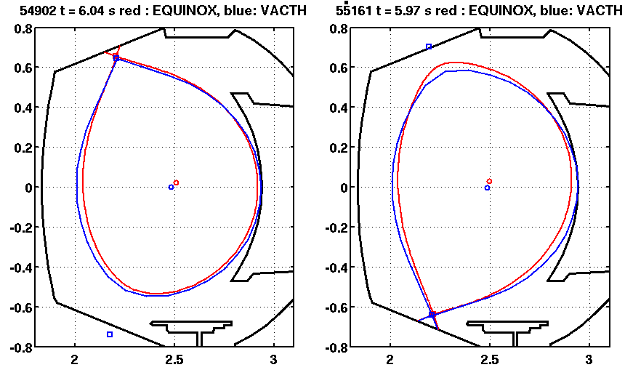
Plasma control
Comparison btw VACTH and EQUINOX equilibrium (500kA/3.6T plasmas)
En USN, différence de l’ordre de 15mm sur le Rext.
En LSN, différence de .. 40mm !
→ Would explain coupling difference measured btw LSN and USN?
Conclusion: probably margin for coupling improvements in C5
From N. FEDORCZAK (18/09)

Slide 11
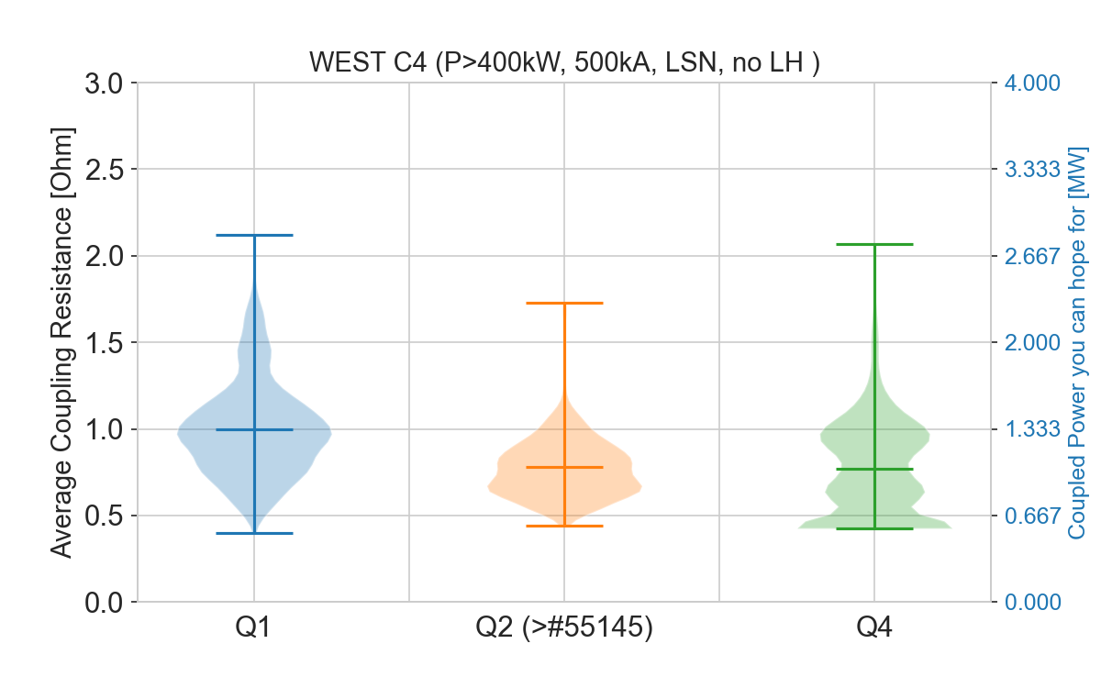
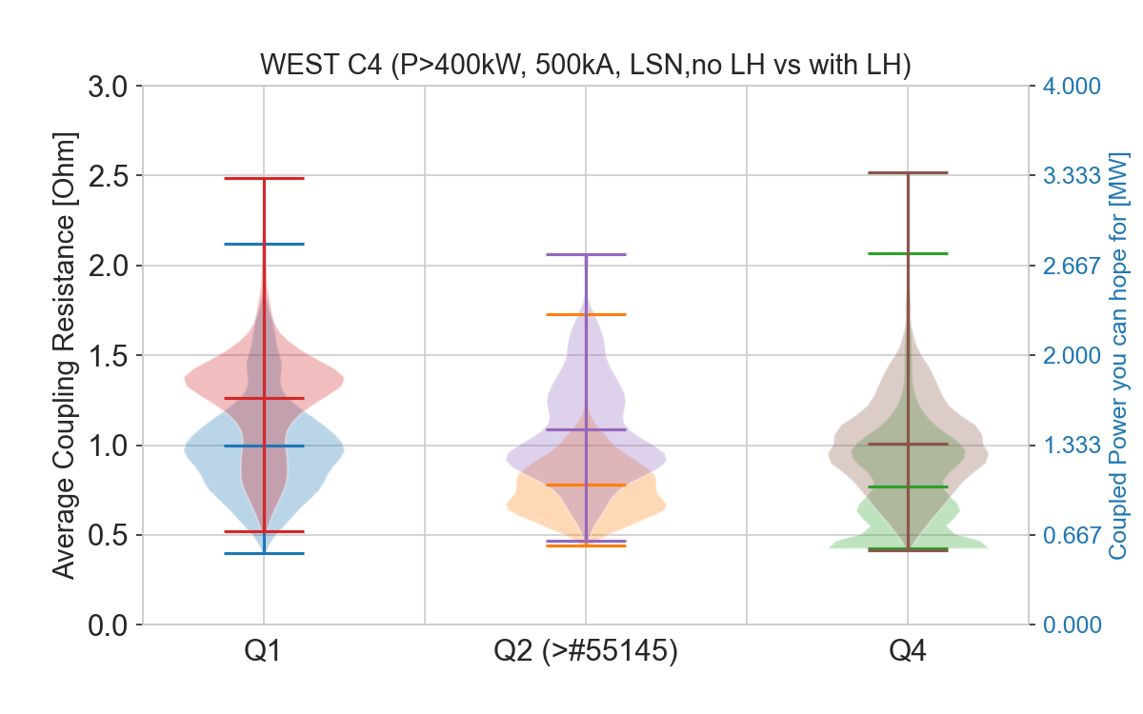
Improving Coupling: LH Power
As observed before, LH power increases IC coupling by ~ 30% in LSN plasmas
Also observed for 700 kA (but reduced database)

Slide 12
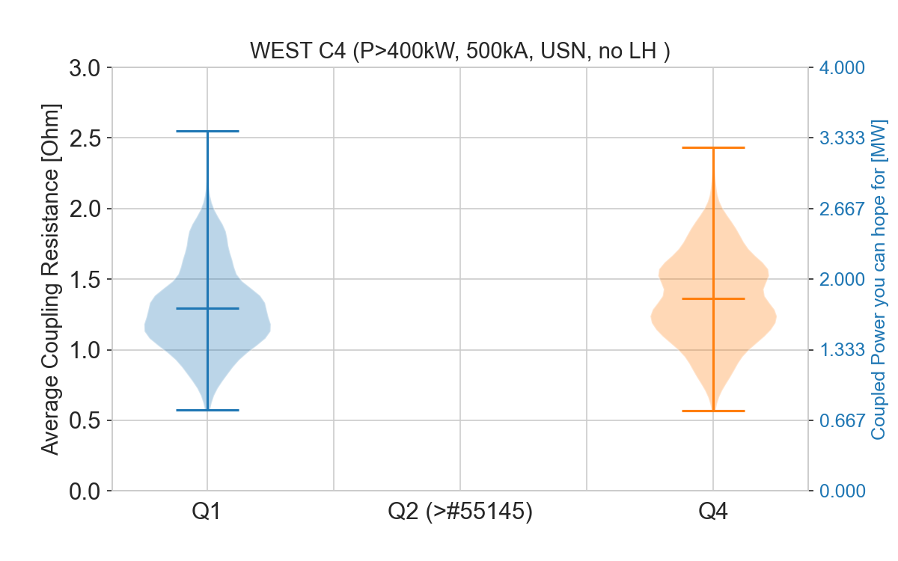
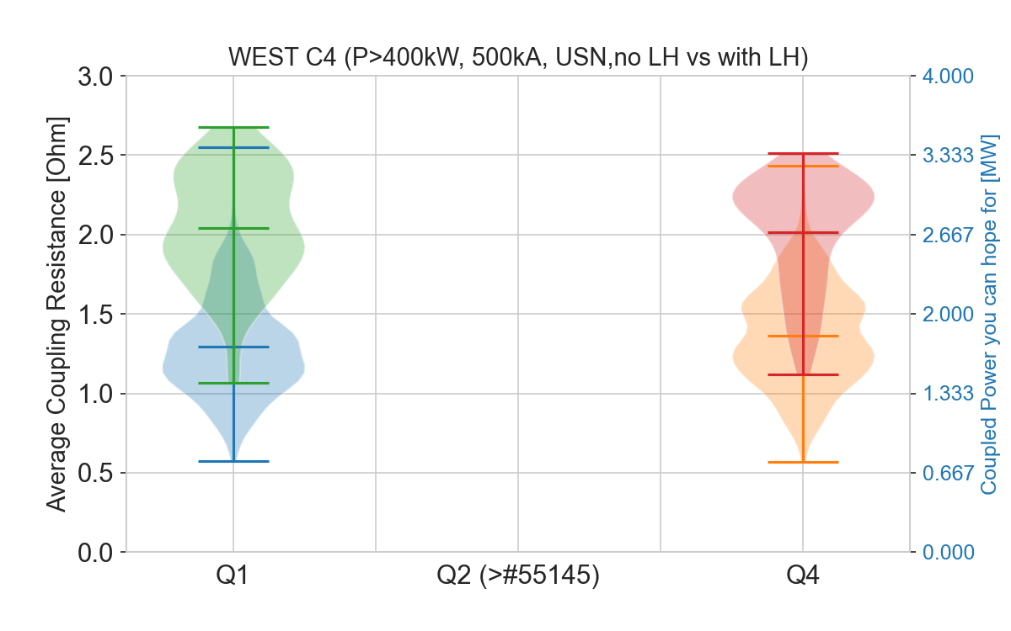
Improving Coupling: LH Power in USN plasmas
Effect of LH combines with effect of USN plasma equilibria → ~ +100%
Not enough data for Q2 in USN

Slide 13
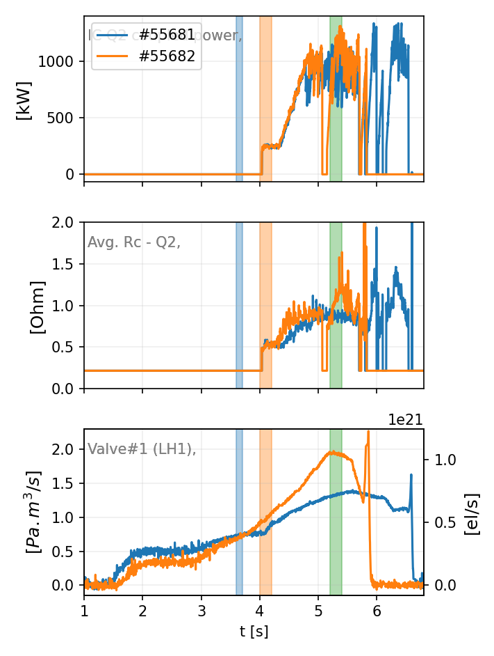
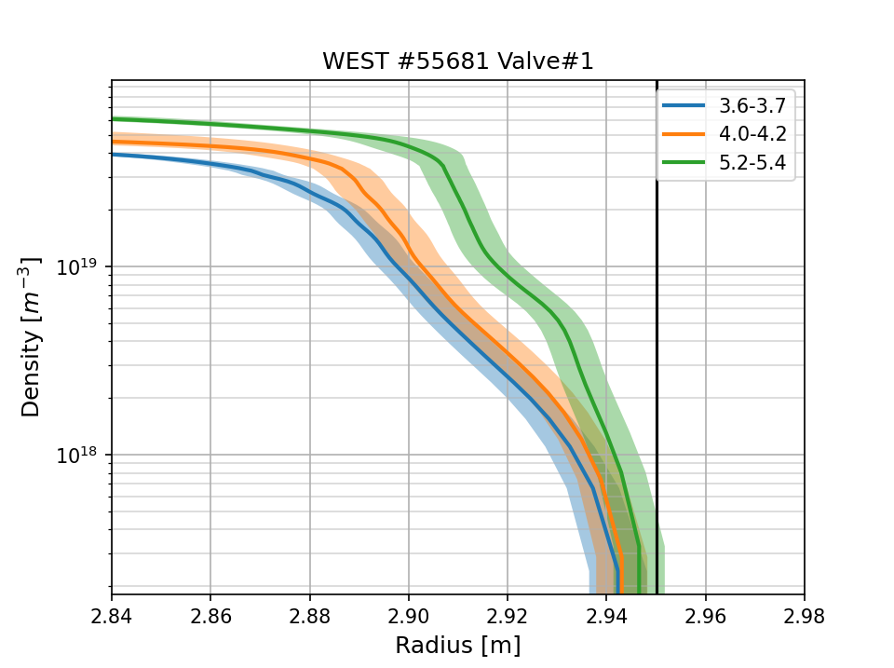
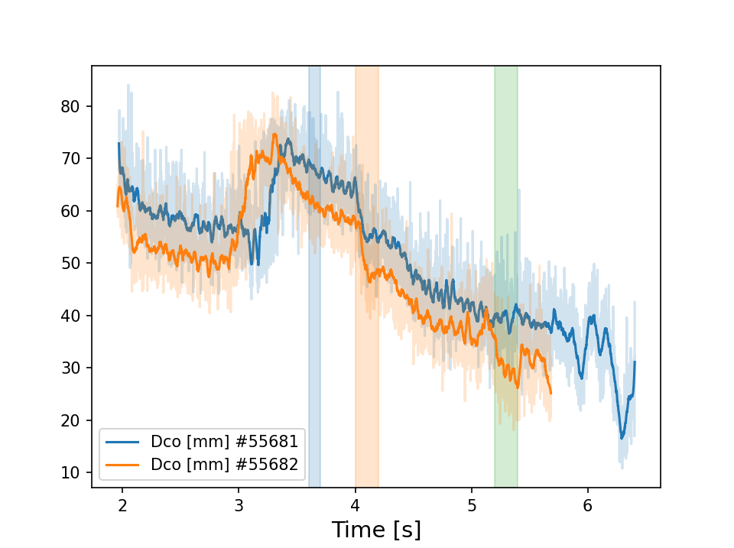
Improving Coupling: Gaz Puffing (not finished)
25/10/2019 - #55681-55682 – 800 kA
Valve#1(LH1) up to 2 Pa.m³/s (1x10²¹ el/s)
Effect on edge density, but not enough to impact Rc Q1
→ not enough gas puffing (tbc)

Slide 14
Summary on coupling experiments (not finished)
In WEST C4,
ICRH Coupling increased with LH power and/or during USN plasmas
Local Gaz puffing was not found effective to increase coupling, but:
Gaz fuelling rate very low due to WEST vacuum pumping limitation
There is hope is vacuum pumping is improved in C5

Slide 15
Phase Control

Slide 16
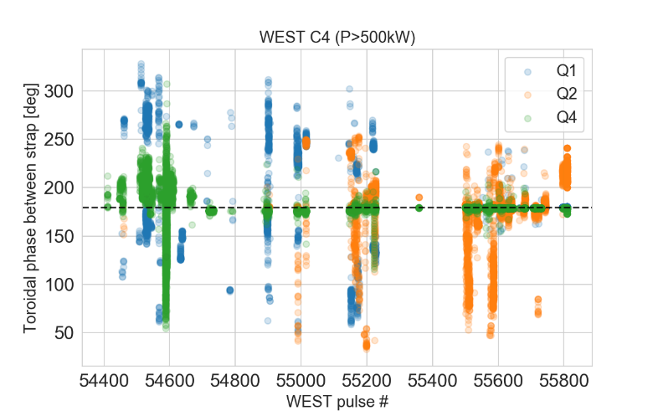
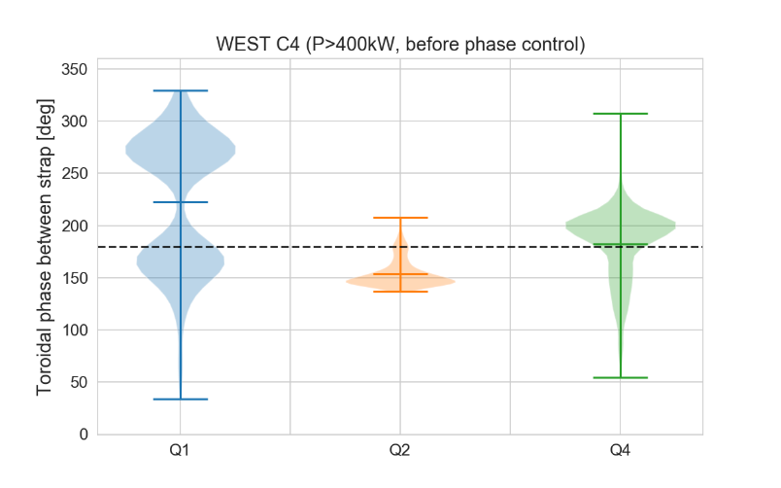
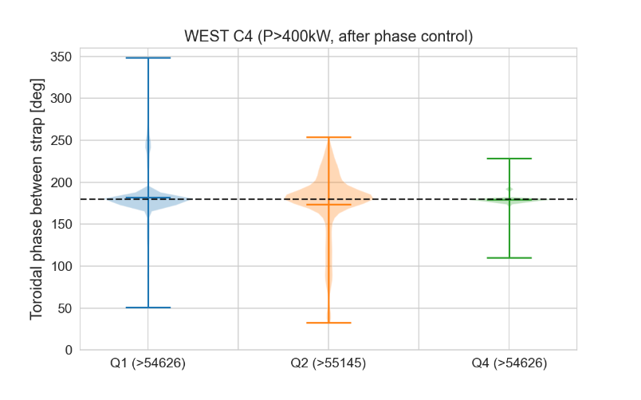
Antenna Toroidal Phase Control
Q4 OK
Q1 OK
Phase control started since #54626 (but not on all antennas/at the same time)
OK for Q4
OK for Q1 (after modifications of the electronic cards, > #)
Not always reliable for Q2
Phase control proven important for operation (see next)

Slide 17
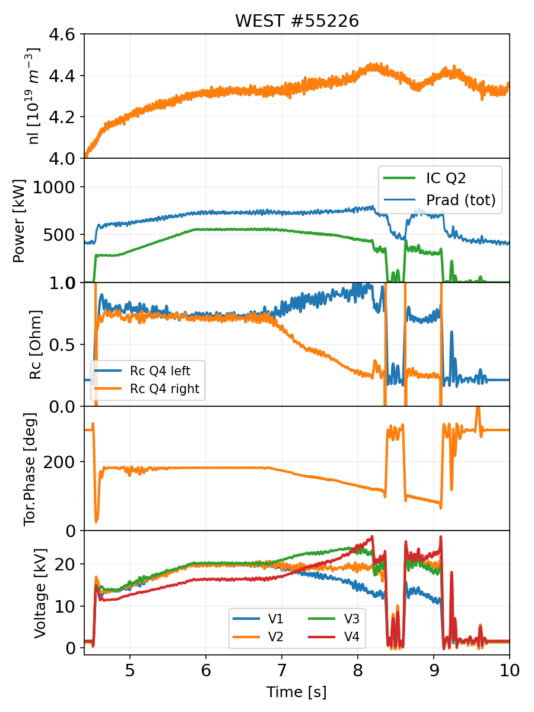
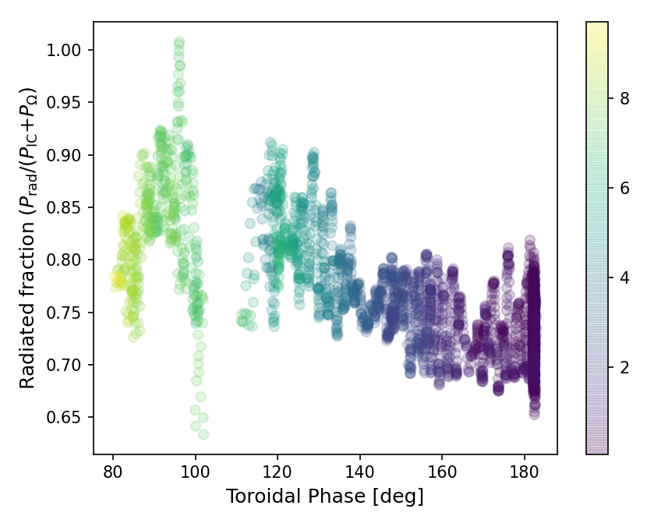
Antenna Toroidal Phase Control
Example of Phase Scan on Q2
Toroidal phase change detunes the antenna
Coupling resistance & voltages unbalance
Associated to an increase of the radiation fraction (but n_{e} not really stationary)
WI radiance increases on lat. limiters as phase decreases (but also voltage increases) and not on divertor (cf. L.Colas) → importance of low Z limiter
Voltage unbalance [kV]

Slide 18
TODO LIST
- Pour le 19/03 je pense que Clarisse attendait de toi une analyse du couplage. En particulier tu persistes à dire "qu'on ne peut pas conclure" sur les injections de gaz locales. Mon impression personnelle est que la technique ne fonctionne pas dans les conditions actuelles. Egalement clarifier quand (Ip=500kA?) et pourquoi on couple mieux en USN.
- Si tu veux participer au lobbying, une couche supplémentaire ne serait pas de trop pour motiver des protections bas-Z.
- Tu avais commencé une étude comparative du rayonnement pendant FCI près/loin des boronisations. Avec dans mon souvenir des fractions rayonnées très disparates selon les journées. Ca tordrait le cou au frad=50% partout et toujours.
- Tu pourrais t'atteler aux chocs forte puissance FCI. Essayer d'en tirer des choses au-delà des records de puissance.

Slide 19
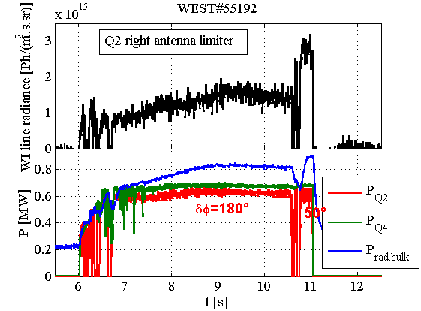
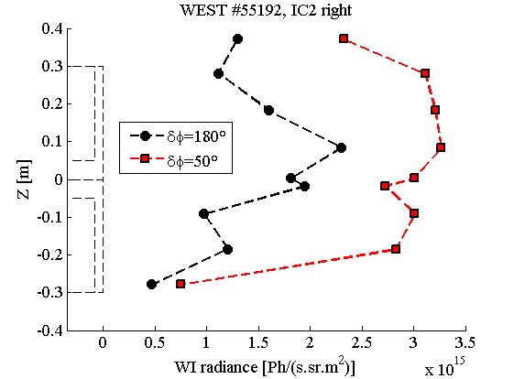
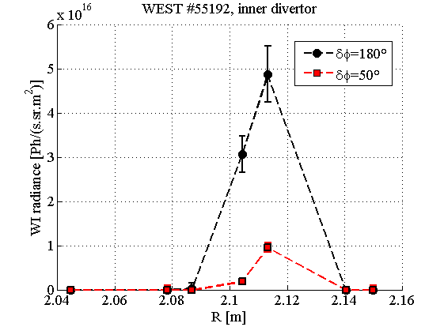
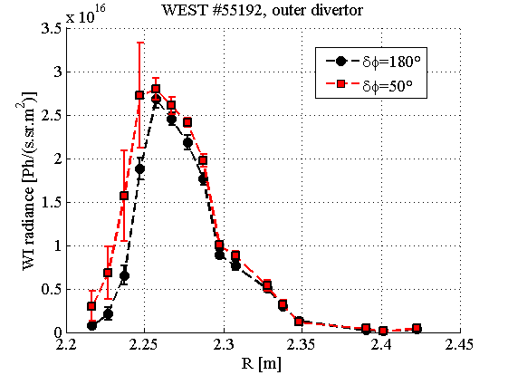
Impurity production vs phase Example: WEST #55192
Failure in Q2 phase control leads to:
Radiated power increase
WI radiance increase on lateral limiters but not on divertor

Slide 20
Load Resilience

Slide 21
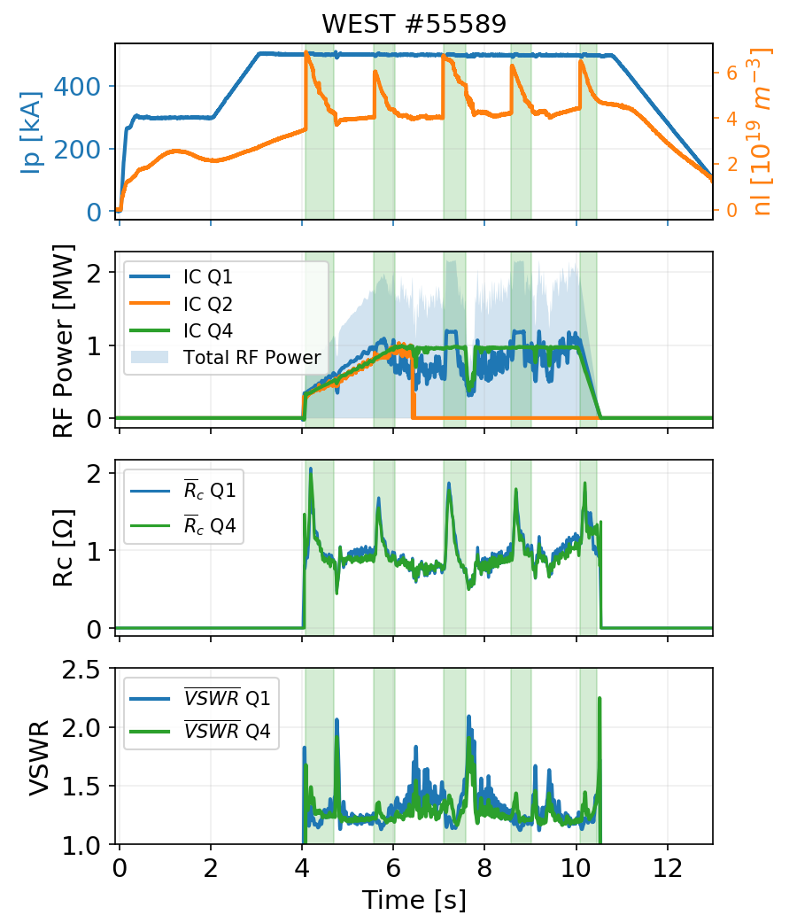
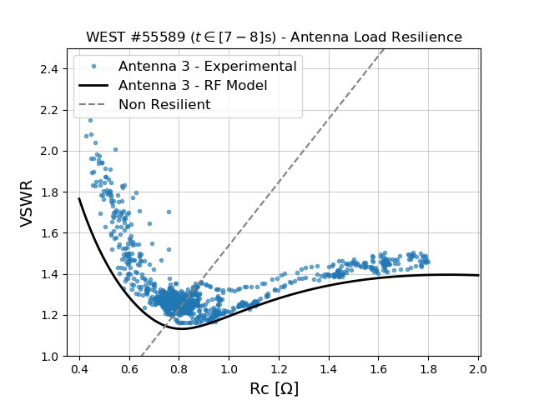
WEST Antennas Load Resilience Confirmed
5 x HFS Pellet Injections
Antenna RF Model fits Measurements
Q1 power feedback
Q2 generator trip

Slide 22
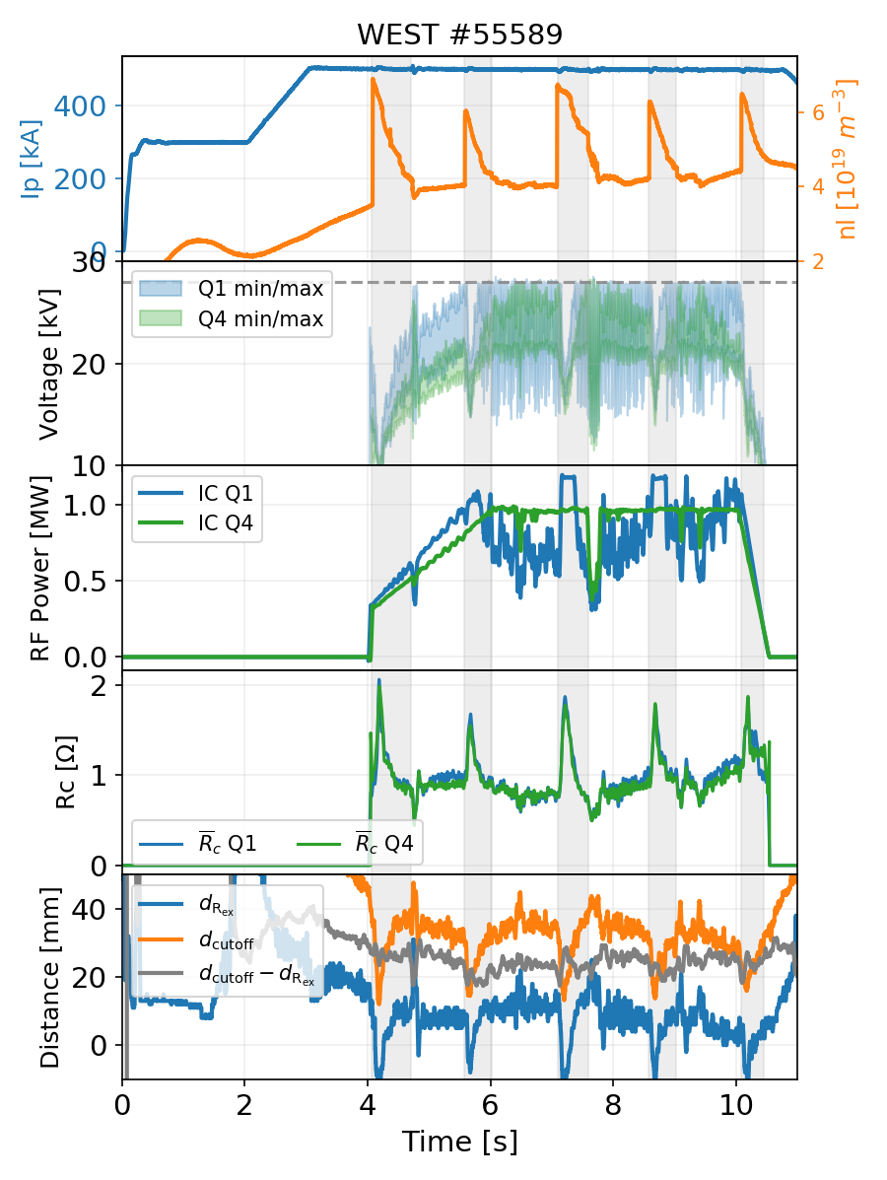
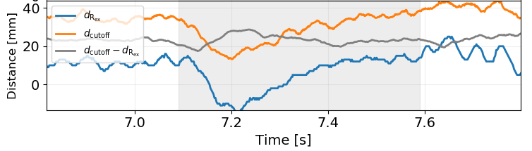
WEST Antennas Load Resilience Confirmed
#55589: other comments
Q1 matching could have been improved (voltage balance) to avoid such power feedback → but 1 capacitor blocked
Changes on edge plasma profile, 2 effects:
Plasma shifts toward antennas during pellets
Density gradient stiffens a bit during pellets
Cut-off closer antenna by 2cm and from LFCS 1cm

Slide 23
Infrared monitoring

Slide 24
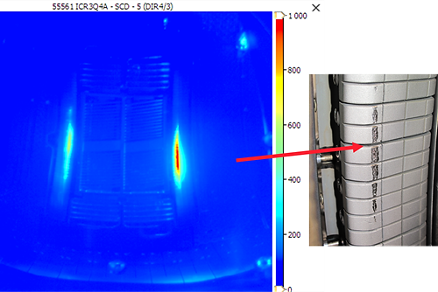
ICRH Antennas Infrared Monitoring during C4
All three ICRH antennas were monitored during the C4 campaign
Automatic power feedback on ROI temperature possible since 13/09/2019
ROI: All antenna limiters; LH antenna; Upper divertor water-cooling tubes (ripple losses)
Only activated for LHCD power real-time control
Q2 Faraday Screen
Temperature threshold exceeded 3 times during C4
Silver coating → low emissivity (Ɛ = 0.03)→ prone to threshold crossing (4 artefacts from dust vs 3 real overheating)
Monitoring not perturbed by parasitic reflections despite high reflectivity of Faraday Screens
Q4 Lateral limiter (W-coated tiles)
Temperature threshold exceeded twice (#55561 and #55807) with T>1050°C
Good correlation with melted zone
If activated, IR safety alarms would have stopped ~10 ICRH shots (17 total) and avoided Q4 damaging
IR feedback on IC power to be setup
IR calibration during campaign important
C. BALORIN - X. COURTOIS, NTT I0002396125

Slide 25
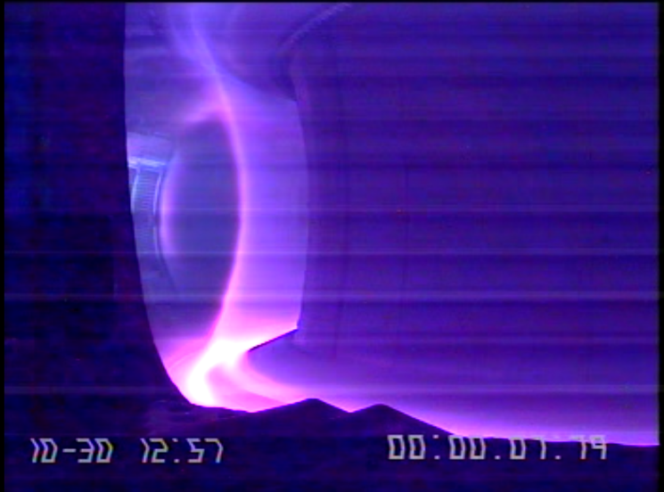
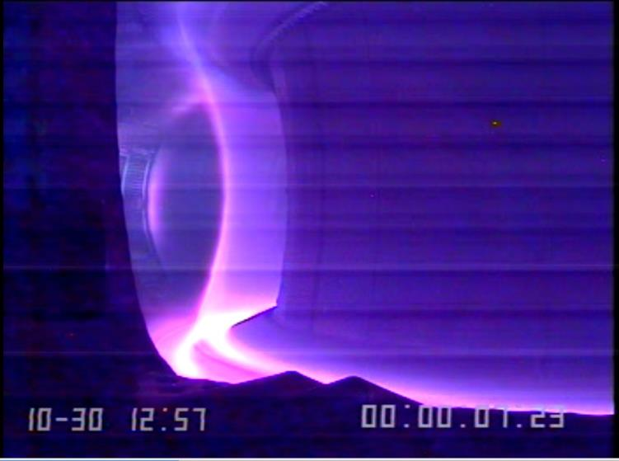
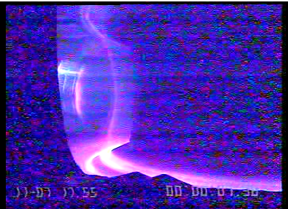
Flashs of light observed on Q4
Ex: WEST visible camera
Visible on few shots with +/- intensity (see next slide)
Nothing visible on Infrared camera
#55714
#55714
#55802

Slide 26
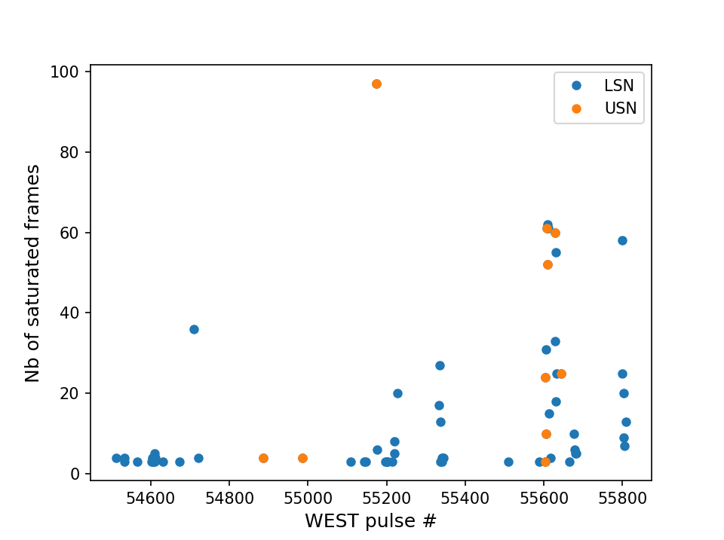
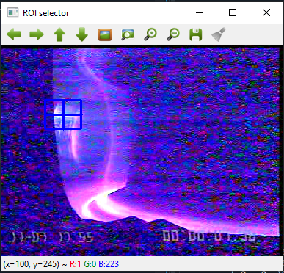
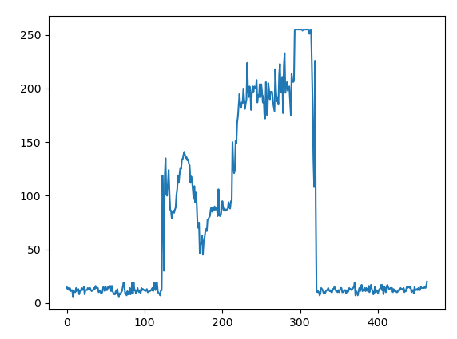
Occurrence of flashes at Q4
Python+OpenCV → ROI Analysis → counted number of saturated frames for all IC plasma videos
Camera saturates quite often (67 detections, ie 18% of Q4 pulses), but not perfect detection method…
Increase of saturation duration ?
Not linked to USN (higher PWI brightness in USN).
Due to RF/IR cables behind? (see next). Generic to all antennas ? (No video)
Saturates during event
“False” detections sometime (just high PWI)

Slide 27
S4 Shutdown Work and perspectives for C5

Slide 28
WEST ICRH System: Summary for C4
Main Results Achieved:
RF plant reliable due to good maintenance during shutdown
All three antennas operational simultaneously on plasma
3 MW/few seconds, 5 MW/500ms, and close to 6 MW peak.
Up to 8 MW total RF power (IC + LH) (close to 9 MW peak)
Load resilience confirmed on all antennas
Notable Incidents:
Regular maintenance performed on plant
Delay on Q4 startup due to cabling defects, solved during maintenance days
Few problems with the hydraulic system (cylinders, position encoder) → All solved during maintenance days
One voltage probe out of order on Q1 → Investigations during S4 (see next)
Two capacitors on Q2 and Q1 can’t move due to out of order servo drive. → Full update of the servo drives and controllers during S4 (see next)

Slide 29
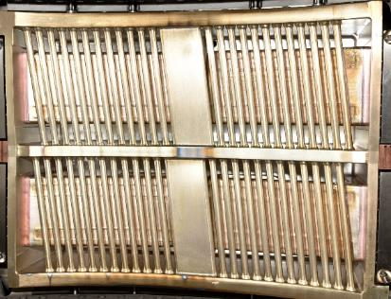
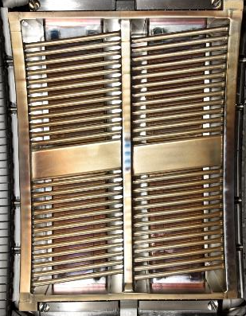
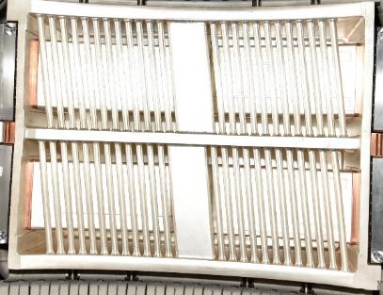
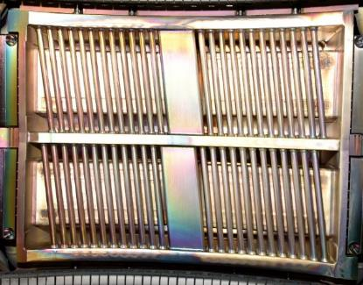
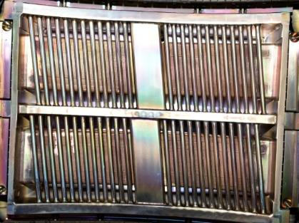
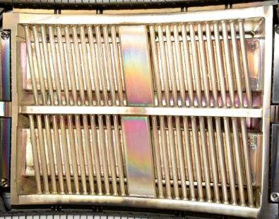
Antennas Status After C4: Front Faces
General Visual Appearance of all antennas OK. More differences from Q4 since its was brand new.
Coating layers increase (visual) on FS (but “removed” on Q2 straps)
Heat loads traces, mostly on right sides
Arcs traces close to strap shorts on all antennas, mostly visible on Q4 (also the most used)
Q1 before/after C4
Q2 before/after C4
Q4 before/after C4

Slide 30
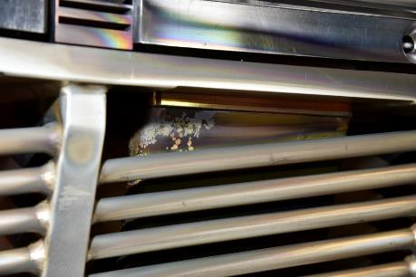
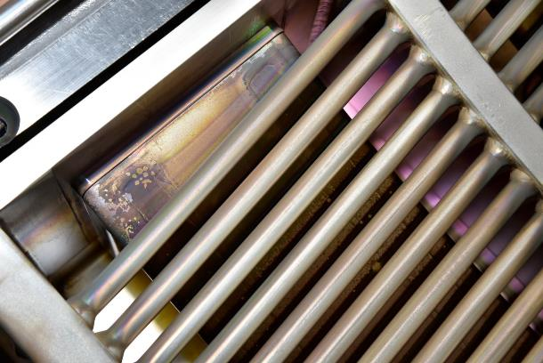
Arc Traces: Q4 Example
Arc Traces more numerous close to the strap short-circuit (low voltage region?)
Seems impressive but the surface is not much affected. “Impurity coating” removed while silver coating seems preserved. Measurements would be interesting but complicated to perform
Work in progress to understand the physical mechanism…

Slide 31
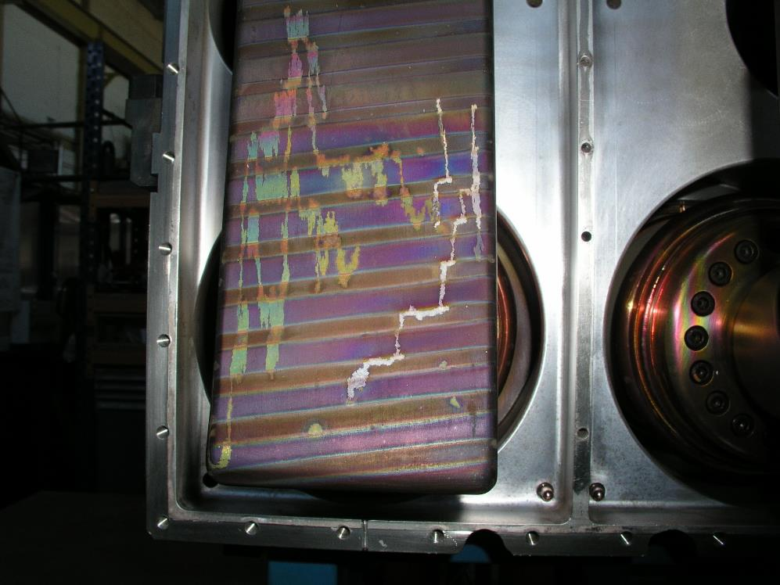
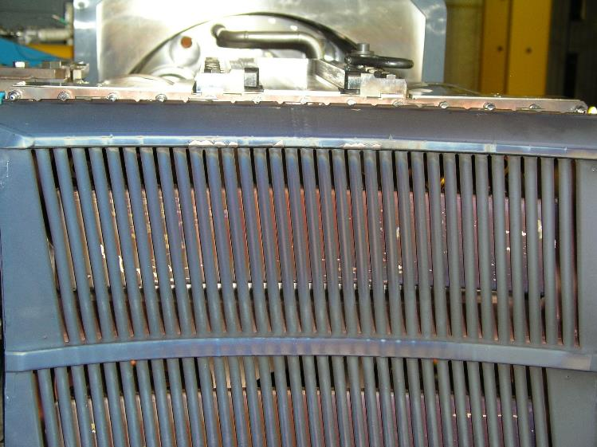
Dark traces behind faraday screen bars
Similar Observations made on TS antennas:

Slide 32
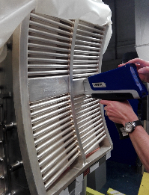
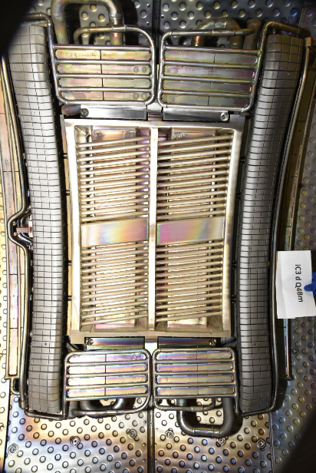
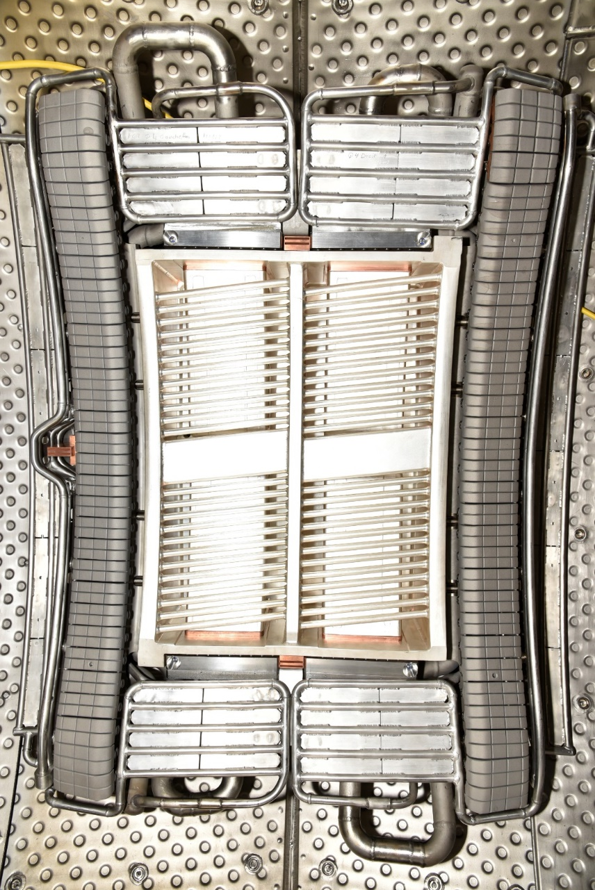
Faraday Screen Front Face Material Evolution
Evolution of the material measured with handheld X-ray fluorescence device
Between S3 and S4:
(Relative) amount of silver reduced (~98%→95%), in particular on right sides
Al/Si/W relative content increased on FS and Cu on straps
L.Delpech
Q4 before C4
Q4 after C4

Slide 33
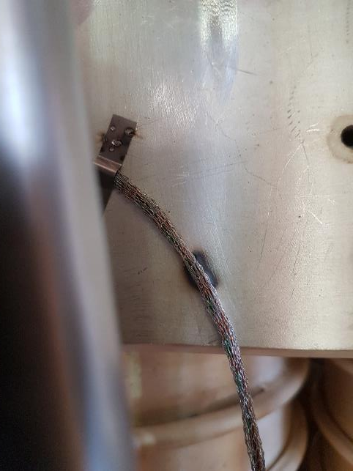

Q1 Voltage Probe
Probe signal lost due to melted RF cable. Q1 Voltage Probe(V1) is OK.
Burning/Melting traces between probe and first grounding jumper
Corrective actions
Add new grounding jumper closer to the probes
Change the cable metallic shielding with stronger ones on Q1, Q2 & Q4

Slide 34



Capacitor Servomotor System Upgrade for C5
WEST Antenna Capacitors are actuated with Tore-Supra motor servo drives
Hardware failures during C4 → some capacitors at fixed position
Despite not optimal matching set, antennas were able to be used thanks to their load-tolerance
But: can’t change frequency and can’t optimize coupling further. Also blocking for restart.
No more spare parts available + obsolete Hardware
An upgrade of the motor servo drives and controllers is in progress…
This upgrade is mandatory to restart ICRH antennas for C5
Controller of 4 servopacks
4 motor servopacks
Antennas motor controllers rack

Slide 35



Phase Control Upgrade for C5
Many problems on phase control, essentially on Q2 & Q1 antennas
Investigation made during S4, problem understood:
Toroidal (Left-right: V1-V3) phase calculated using 3 phase detectors. → If the phase of one of this detector turns by 360°, control fails
Example of failure of phase control (Q2)
Φ (P_{fwd/left} – P_{fwd/right})
-
Φ (P_{fwd/left} - V1)
+
Φ (V1 – V3)
Φ (P_{fwd/right} - V3)
To control
Solution found:
Use a dedicated phase detector for V1-V3 measurement → Measurements centred on 180° and can’t turn
Tests in progress and seem positive
Φ (P_{fwd/left} - V1)
+
Φ (V1 – V3)
-
Φ (P_{fwd/left} – P_{fwd/right})
Φ (P_{fwd/right} - V3)
To control

Slide 36
WEST record of stored energy and neutron rate with 5MW ICRH power
Time (s)

Slide 37
Conclusion

Slide 38
WEST ICRH during C4: Conclusion

